Slide 1
PROJECT SYNOPSIS
Introduction
The Online Banking System is a comprehensive digital banking platform designed to offer a seamless and secure experience for users to manage their finances. With the growing trend towards digital transformation in the financial sector, this system provides a secure, efficient, and accessible way for customers to conduct banking transactions remotely.
It includes three key interfaces:
User Interface (UI): Provides customers with easy access to their account details, transaction history, fund transfers, and more.
Admin Interface: Gives bank administrators control over user management, transaction oversight, and system operations.
Employee Interface: Assists bank employees in providing customer support, resolving issues, and managing service requests efficiently.

Slide 2
By incorporating modern web technologies such as HTML, CSS, JavaScript, Python, and MySQL, this system ensures real-time processing, high security, and an intuitive experience for all users.
With the increasing reliance on digital platforms, this Online Banking System integrates the needs of three critical user groups:
End Users (Customers) who require an efficient, secure, and accessible platform to manage their banking tasks.
Bank Employees who provide assistance and handle service-related requests or
issues faced by the users.
Bank Administrators who have the highest level of control, allowing them to manage users, oversee the system's performance, generate reports, and monitor transactions in real time.

Slide 3
Abstract
The Online Banking System is a web-based platform designed to manage banking tasks online, enabling customers, administrators, and bank employees to perform their specific roles efficiently.
The system includes the following components:
User Interface: Provides customers with the ability to perform tasks such as transferring funds, checking account balances, paying bills, and viewing transaction history, all from a secure login.
Admin Interface: Allows administrators to oversee all banking operations, including managing users, reviewing transactions, generating reports, and maintaining the security of the system.
Employee Interface: Empowers bank employees to handle customer queries, process account updates, and assist with technical or transactional issues.
Utilizing HTML, CSS, JavaScript, Python, and MySQL, the system offers an efficient, scalable, and secure platform for banking activities.

Slide 4
Overview
The Online Banking System operates with three primary user interfaces, each designed to handle distinct tasks:
User Interface:
User Login: Customers log in securely with their credentials and access their accounts.
Account Management: Users can check balances, view transaction history, and update personal information.
Transactions: Users can initiate money transfers, pay bills, and request financial statements.
Security Features: Two-factor authentication and encrypted communication ensure that all activities are secure.

Slide 5
Admin Interface:
User Management: Administrators can create, update, or deactivate user accounts as needed.
Transaction Monitoring: Admins can view detailed transaction logs and manage flagged activities.
System Security: Admins monitor system security, review user activity reports, and perform routine audits.
Reporting Tools: Admins can generate daily, weekly, or monthly reports on system activity and financial transactions.
Employee Interface:
Customer Support: Employees assist users with inquiries and resolve account-related issues.
Account Assistance: Employees help users with lost passwords, account discrepancies, or transaction-related problems.
Transaction Assistance: Employees can process transfer requests, update transaction statuses, and resolve issues flagged by customers.

Slide 6
How and why it is useful for Users
User Interface:
24/7 Accessibility: Users can access their accounts and perform banking transactions anytime and from anywhere, as long as they have an internet connection.
Efficiency: Customers can perform routine banking tasks such as transferring money, checking balances, and paying bills in minutes without needing to visit a branch.
Security: Advanced encryption and multi-factor authentication ensure that all data is secure, and unauthorized access is prevented.
Admin Interface:
Comprehensive Control: Admins have full access to all user data, system logs, and transaction histories, enabling effective management and oversight of banking activities.
Real-time Monitoring: Admins can monitor system performance and transactions in real-time, ensuring smooth operations and preventing fraudulent activities.
Improved Decision-making: The ability to generate detailed reports helps admins make informed decisions on system improvements and customer service enhancements.

Slide 7
Employee Interface:
Customer Assistance: Employees can assist users in resolving any
banking-related queries or issues, enhancing customer satisfaction.
Efficient Issue Resolution: With access to account details and transaction
histories, employees can quickly identify and resolve issues,
ensuring minimal delays for customers.
Transactional Help: Employees can ensure that transactions are completed
successfully, especially if there are any errors or delays,
improving user experience.

Slide 8
Literature Review
Research in the field of online banking has highlighted the shift towards digital platforms as a means to increase both accessibility and efficiency in the financial sector. Studies indicate that the rise of mobile banking apps and web interfaces has transformed the way users interact with banks, making services more convenient, reducing operational costs, and offering real-time transaction processing.
Key challenges identified in literature include:
Security: As online banking becomes more prevalent, security concerns such as fraud prevention, data breaches, and identity theft are of increasing importance. Studies emphasize the need for strong encryption methods, two-factor authentication, and secure communication protocols.
User Experience: Enhancing the user experience has become a primary focus, with an emphasis on intuitive interfaces, faster transaction processing, and more personalized services.
Multi-user Interfaces: The inclusion of multiple interfaces (for users, admins, and employees) is an emerging trend in modern banking systems. Research has shown that these interfaces can improve customer satisfaction, streamline operational tasks, and improve data management and security.

Slide 9
Technologies Used
Frontend Technologies:
HTML: Provides the structure of the platform, ensuring content such as forms, buttons, and text are displayed correctly.
CSS: Defines the style and layout of the web pages, ensuring the site is visually appealing and responsive across various screen sizes and devices.
JavaScript: Adds dynamic behavior to the website, including interactive forms, real-time updates on balances and transactions, and client-side validation for secure input.
Backend Technologies:
Python: Powers the server-side logic, handling everything from authentication to transaction processing. Python scripts communicate with the MySQL database to fetch and store data securely.
Database:
MySQL: A relational database management system used to securely store user data, transaction histories, financial records, and system logs. It enables efficient retrieval and updating of data during real-time operations.

Slide 10
How It Works (Manually and Automatically)
Manual Workflow:
User Workflow:
Registration: Users enter personal details to create an account.
Login: After authentication, the user accesses their dashboard.
Transactions: Users initiate transactions, and the system processes them in real-time.
Logout: After completing tasks, users log out to secure their accounts.
Admin Workflow:
User Management: Admins can add, delete, or modify user accounts based on requests or system requirements.
Transaction Monitoring: Admins review transaction logs to ensure proper processing and security compliance.
Reporting: Admins can generate reports detailing user activities, transaction volumes, and system performance.

Slide 11
Employee Workflow:
Customer Service: Employees assist users by handling queries, verifying account information,
and processing service requests.
Transaction Assistance: Employees help users with money transfers, fund discrepancies,
and ensure accurate processing.
Automatic Workflow:
When a user initiates a transaction, Python backend scripts validate the data, interact with the MySQL database, and process the transaction in real-time.
Admins and employees can access real-time data from the MySQL database and monitor activities, ensuring timely resolution of issues.

Slide 12
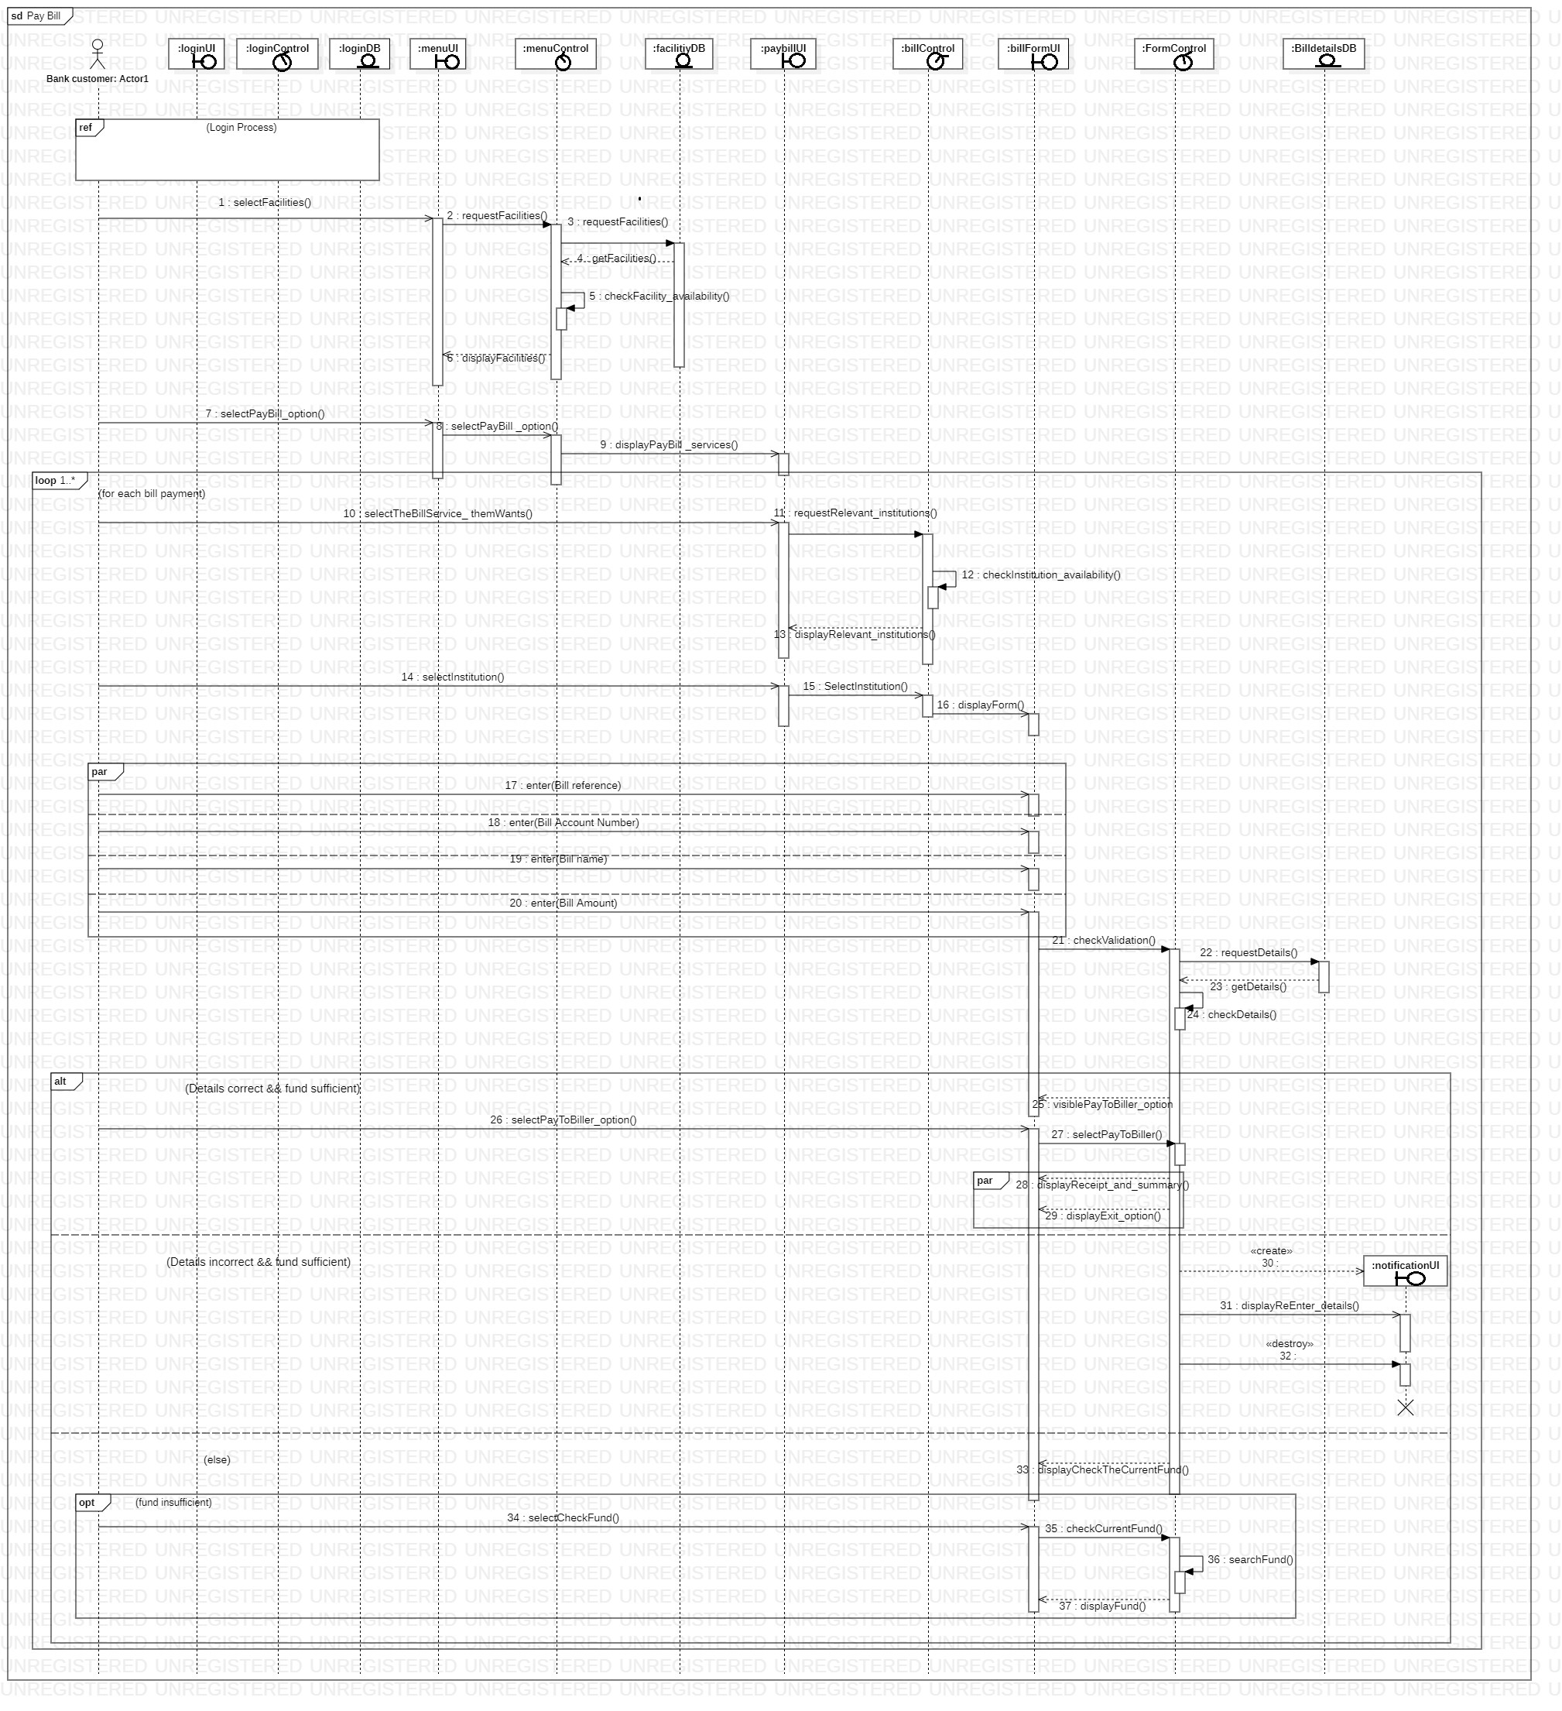
Sequence Diagram

Slide 13
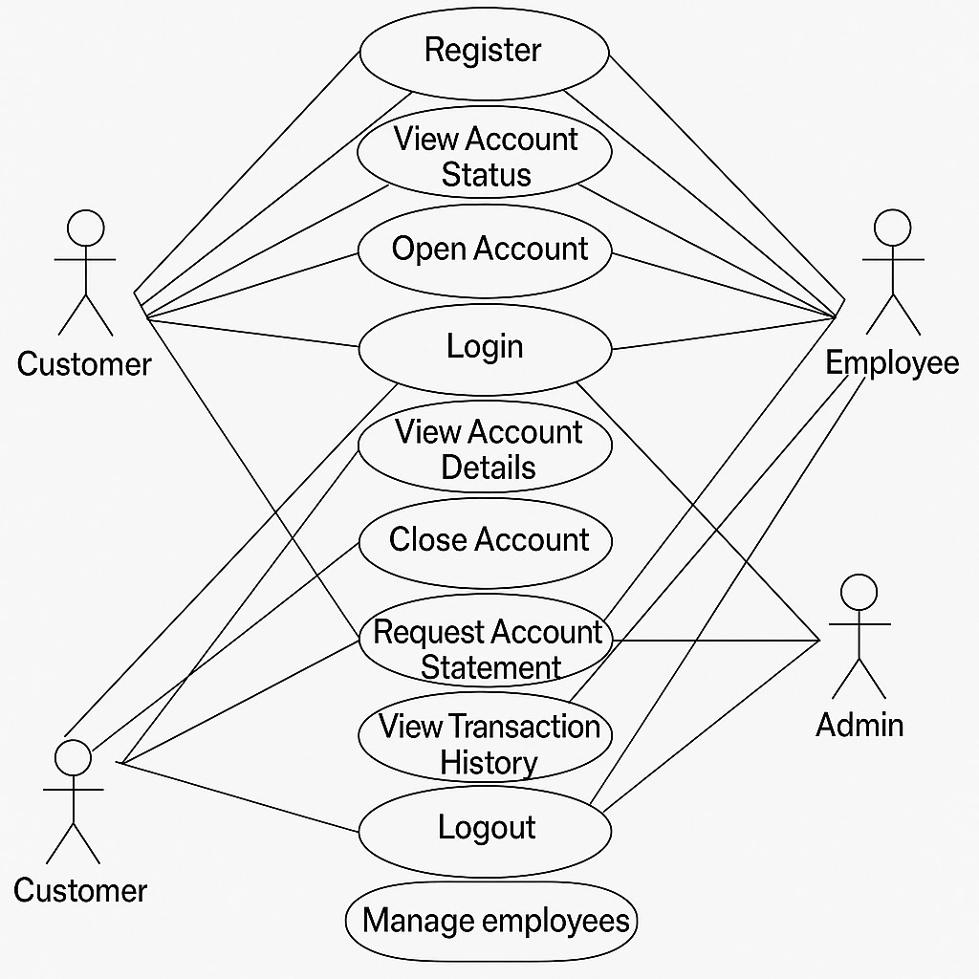
USE CASE DIAGRAM

Slide 14
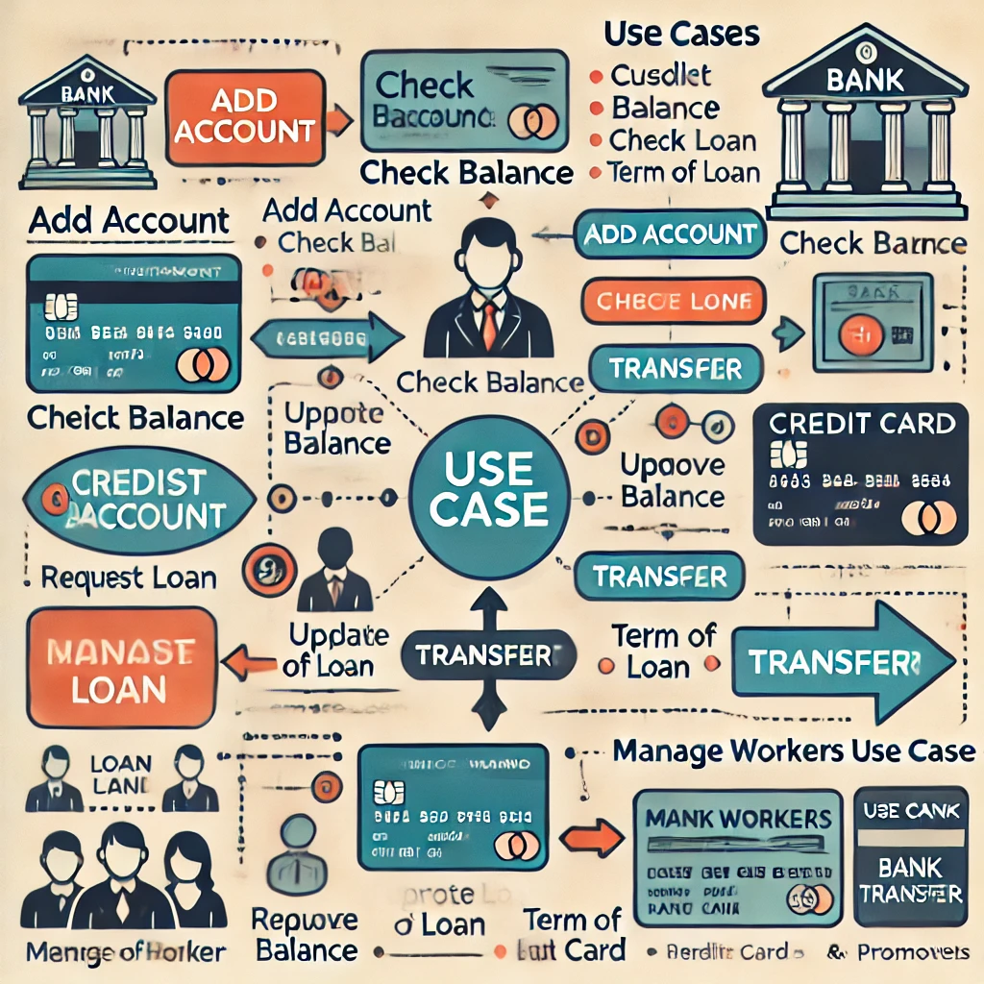

Slide 15
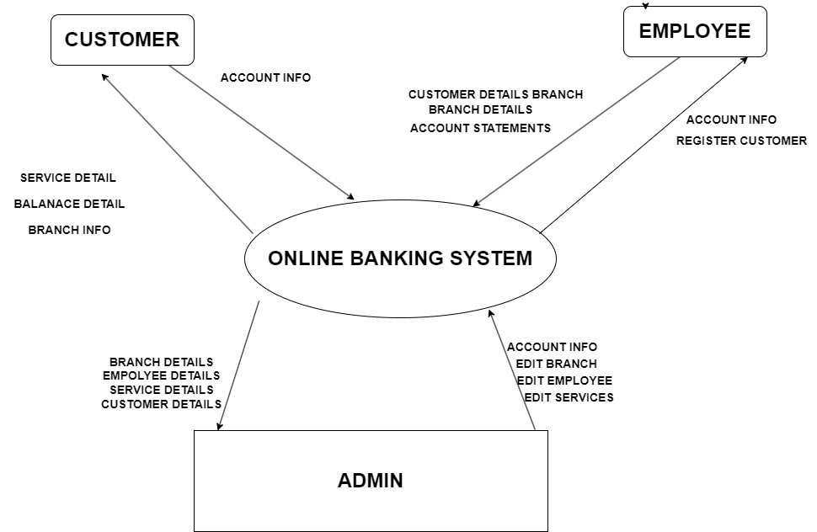
DATA FLOW DIAGRAMS (DFD)
Level 0

Slide 16
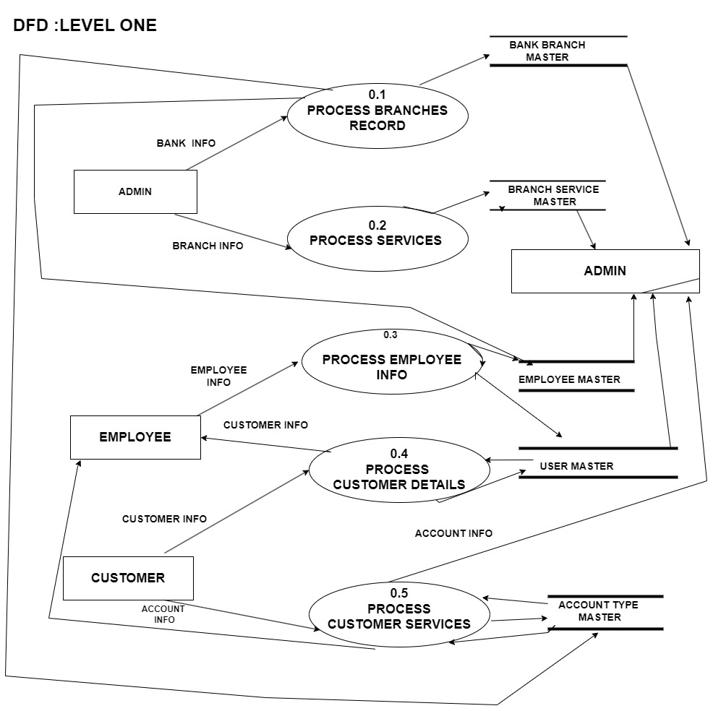

Slide 17
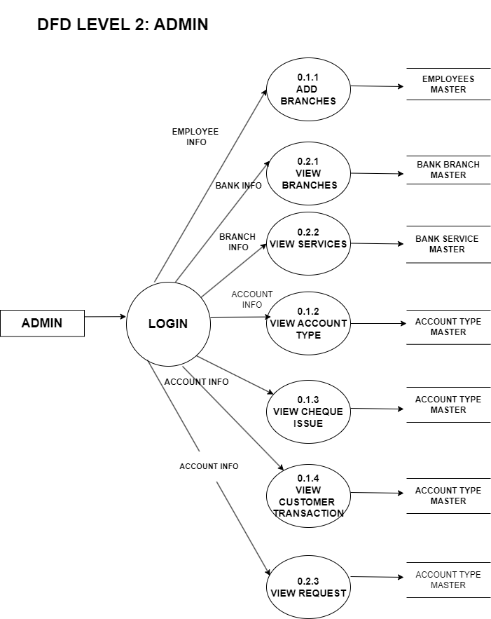

Slide 18
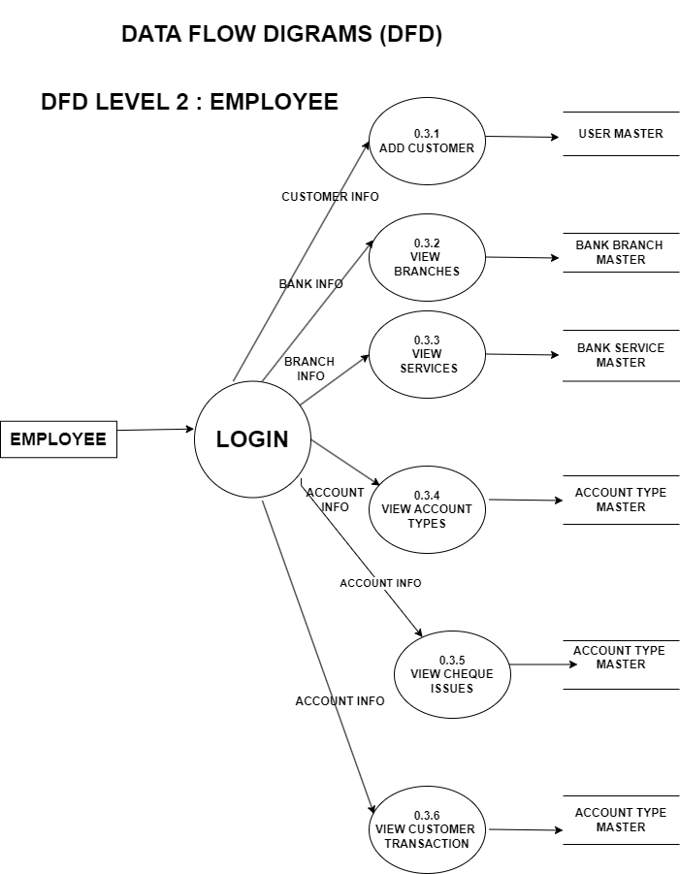

Slide 19
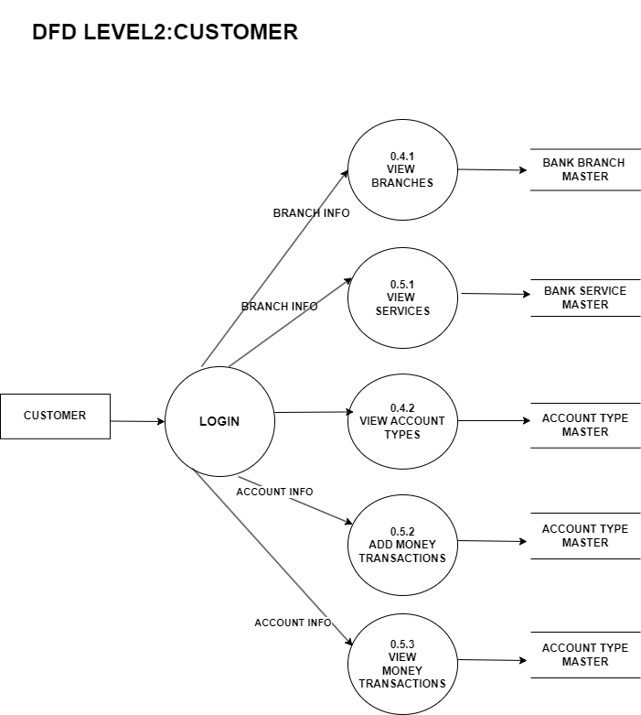

Slide 20
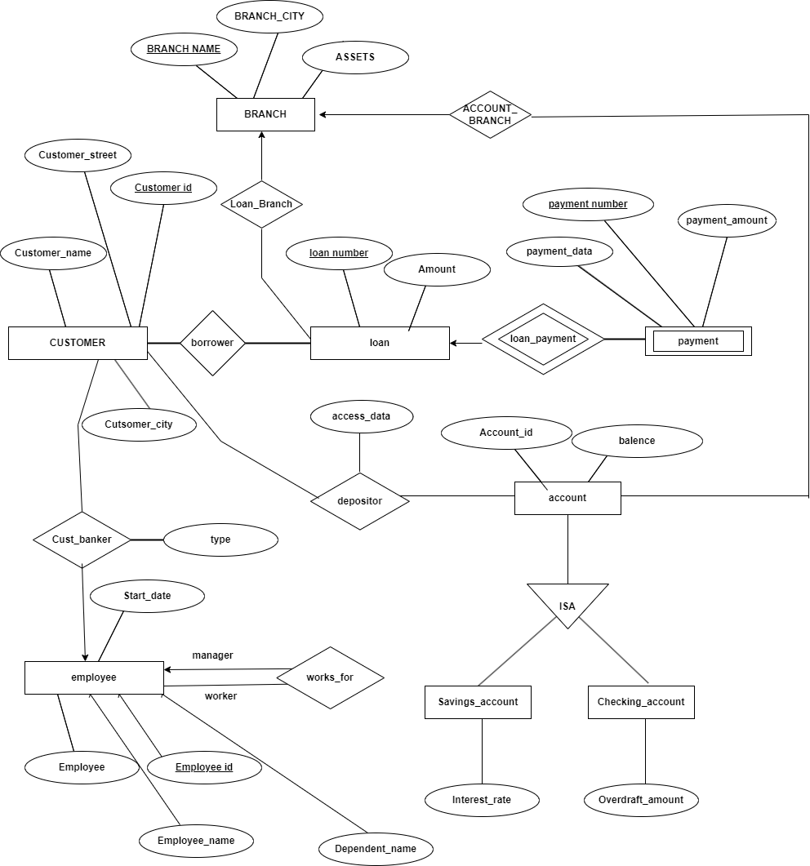
ER DIAGRAM

Slide 21
Conclusion
The Online Banking System represents a significant advancement in the way financial services are delivered to users. By providing distinct interfaces for users, admins, and employees, the system ensures that each stakeholder can efficiently perform their role. The system is designed with security, efficiency, and user experience in mind, utilizing modern technologies like HTML, CSS, JavaScript, Python, and MySQL.
With this solution, users can manage their accounts securely from anywhere, admins can oversee the entire platform, and employees can provide dedicated customer support. As digital banking continues to evolve, this system provides a solid foundation for future developments, including mobile integration, enhanced security measures, and advanced data analytics.

